Slide 1
Calculate Table
Calculate Table

Slide 2
Calculate Table
Note: This demonstration uses the AdventureWorks2016 database and more specifically the DimProduct and FactInternetSales tables .
Start by creating a measure that calculates the average amount of revenue generated corresponding to the product class "M" .
AVG Sales Class M =
CALCULATE (
AVERAGEX(FactInternetSales,FactInternetSales[OrderQuantity])
* AVERAGE (FactInternetSales[UnitPrice]),
DimProduct [Class] = "M"
)

Slide 3
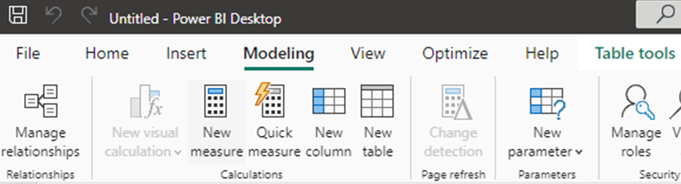
Calculate Table
In the Modeling tab, click New Table.

Slide 4
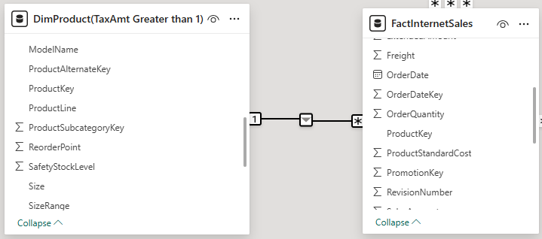
Calculate Table
Create a view of the DimProduct table that leaves only products with a tax value greater than 1.
DimProduct ( TaxAmt Greater than 1)= CALCULATETABLE ( DimProduct , FILTER ( FactInternetSales , FactInternetSales [ TaxAmt ] > 1 ))
We have to establish the relationship between the new calculated table and FactInternetSales

Slide 5
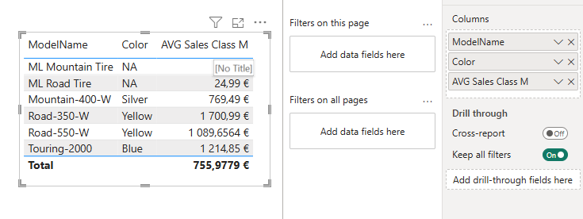
Calculate Table
The we try to represent the data composed by fields form the new calculeted table and the new created measure

Slide 6
Thank you
Thank you

